Slide 1
AMAZON LISTING AUDIT REPORT
BY NOMAN

Slide 2
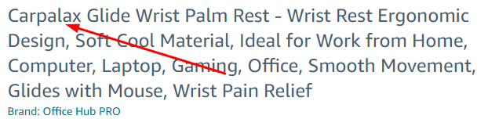
Brand name is missing in the starting Title

Slide 3
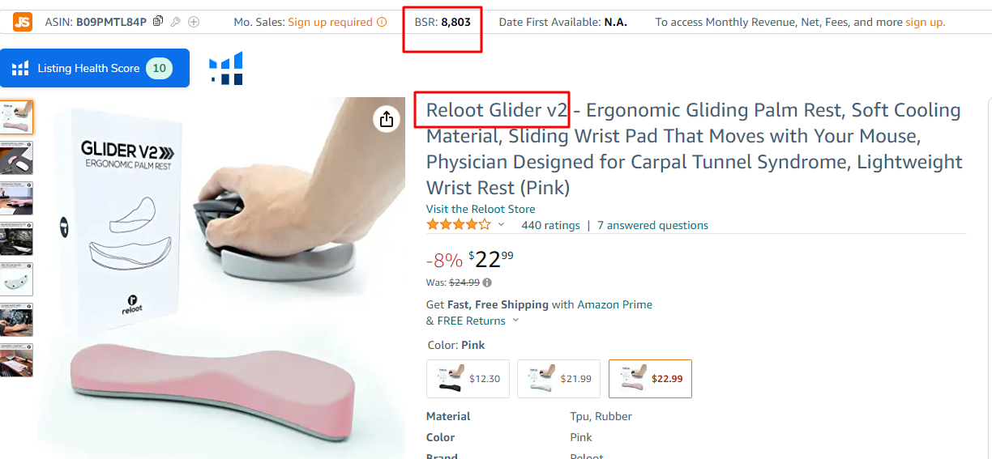
Competitor bsr(Best seller rank ) and brand name

Slide 4
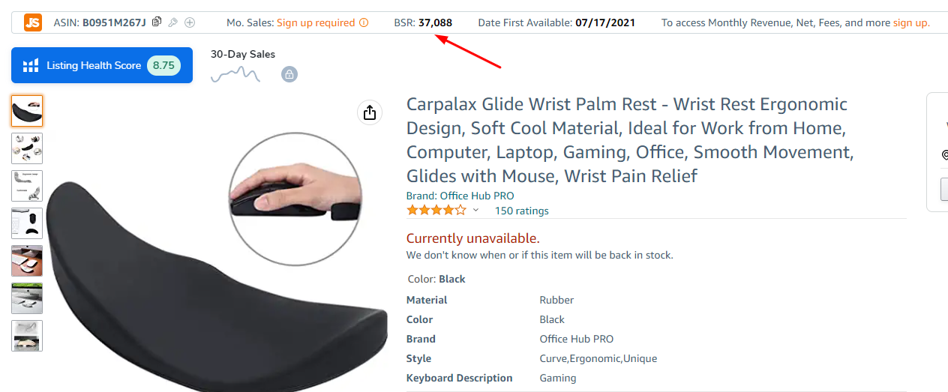
Our BSR is poor due to poor keyword indexing

Slide 5
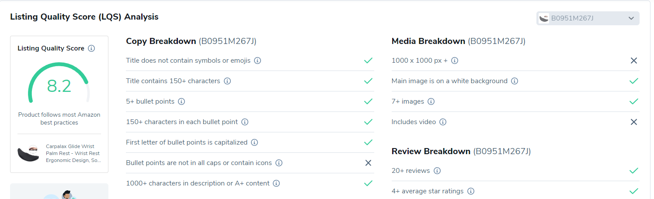
Listing quality Score of our product
Picture size is not correct , there is no video available , bullet points are not well written

Slide 6
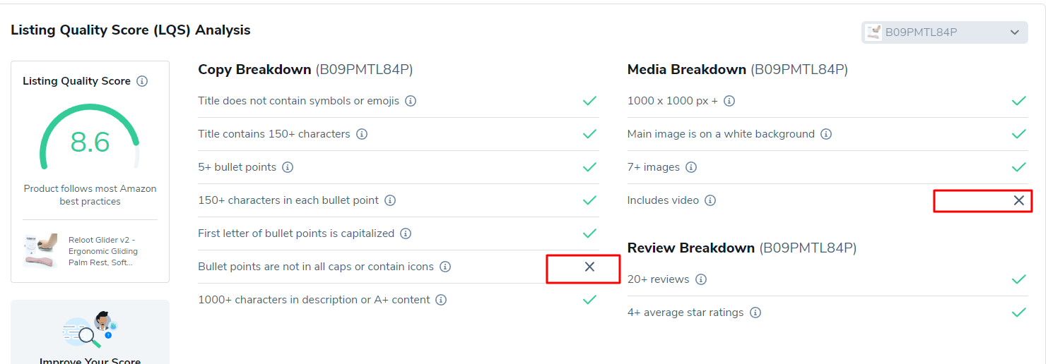
Competitor lqs

Slide 7
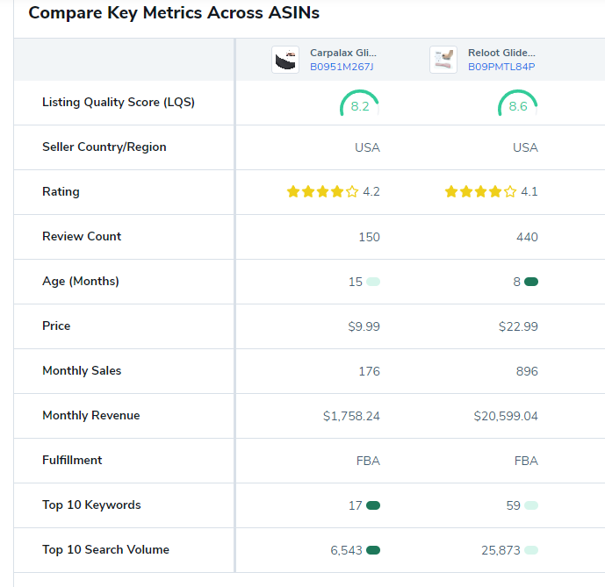
Listing Comparison with our competitor
Our product don’t have enough top relevant keywords
Our Listing quality score
Competitors

Slide 8
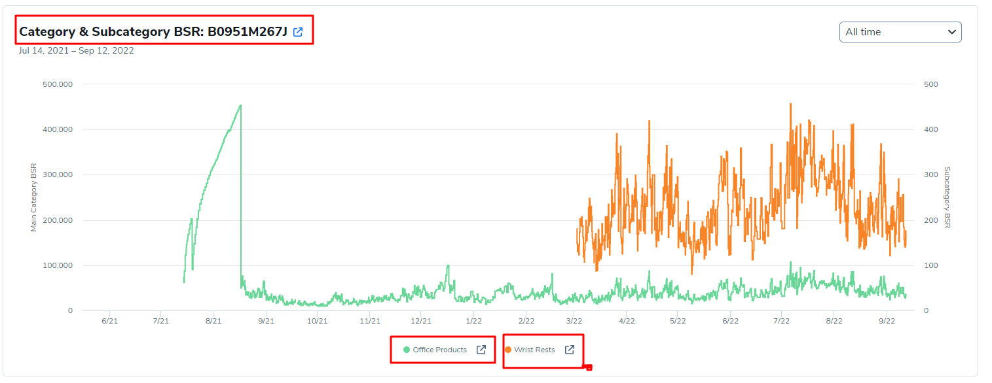
Our category and sub-category BSR ranking

Slide 9
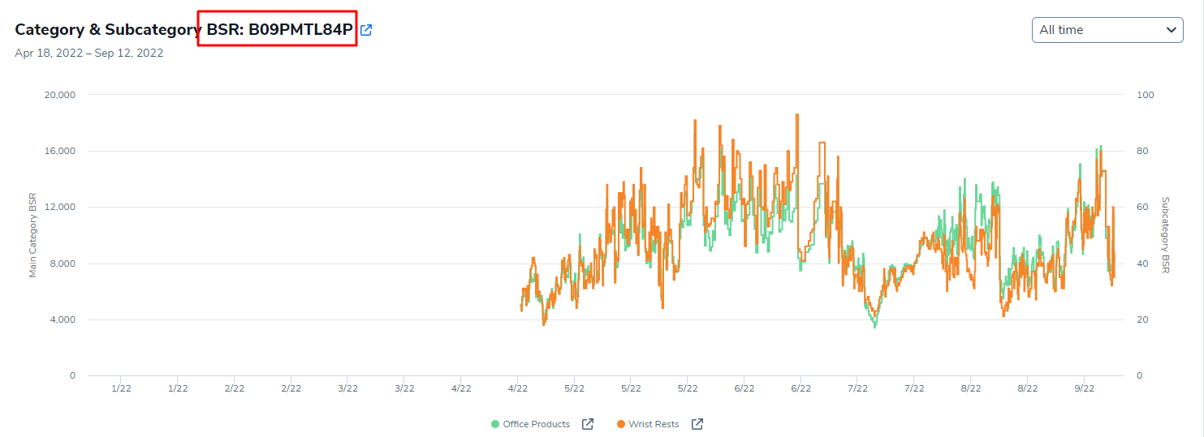
Competitor category bsr

Slide 10
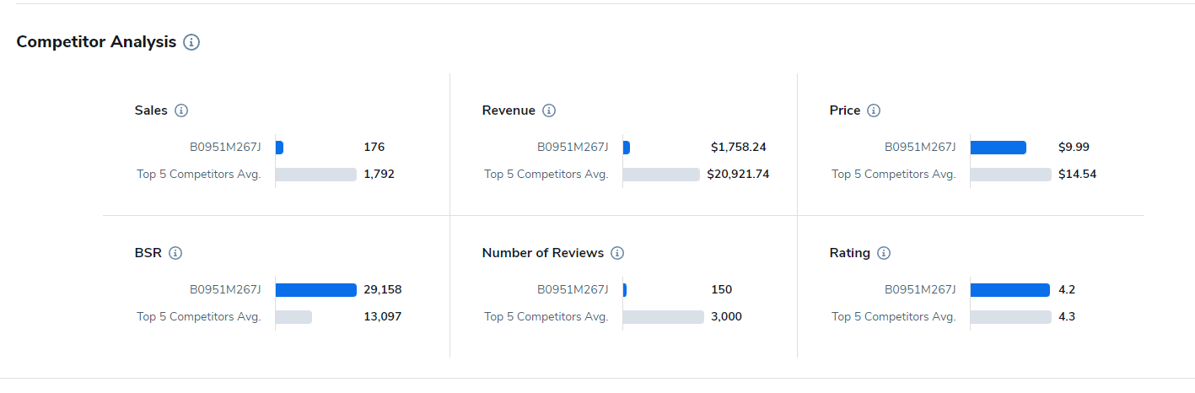
Comparison analysis of our product with top 5 products

Slide 11
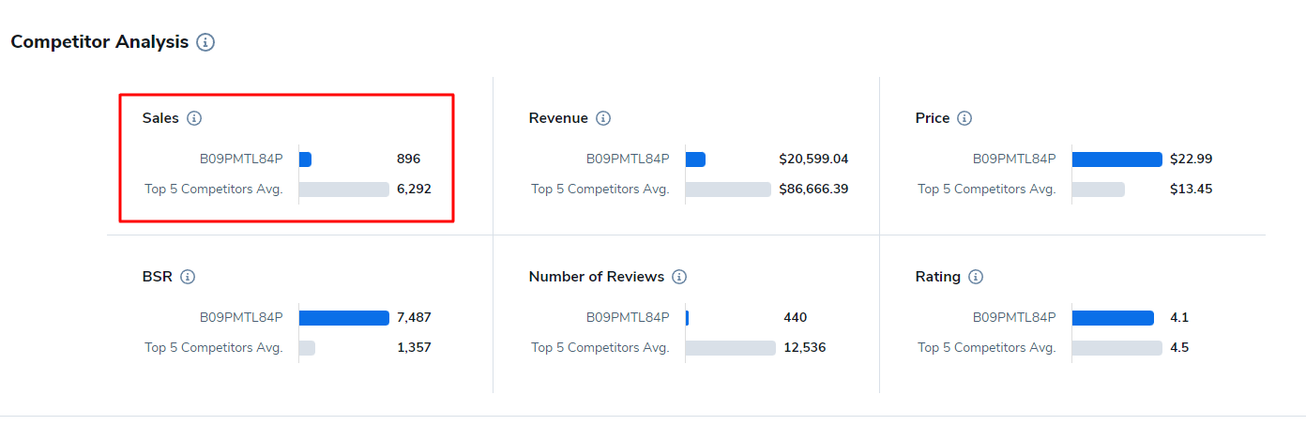
COMPERISON ANALYSIS OF COMPETITOR WITH top 5 competitors

Slide 12
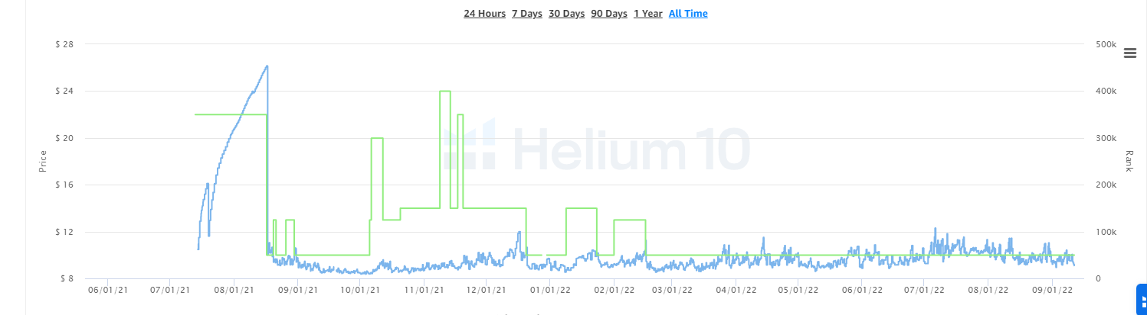
Our product sales graph

Slide 13
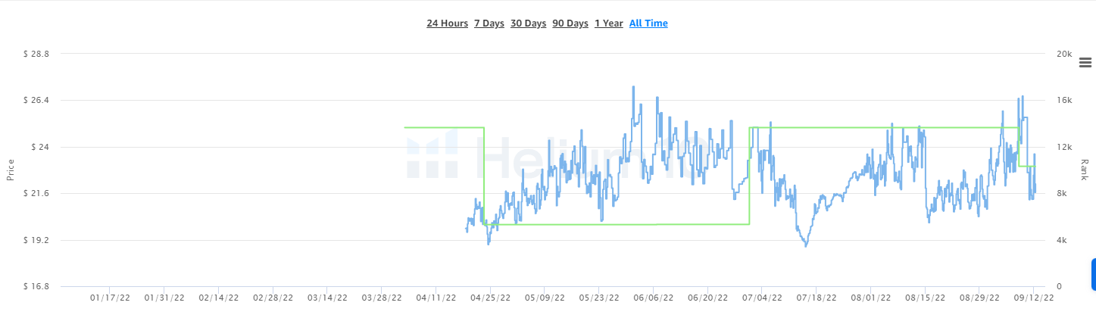
Competitor sales graph

Slide 14
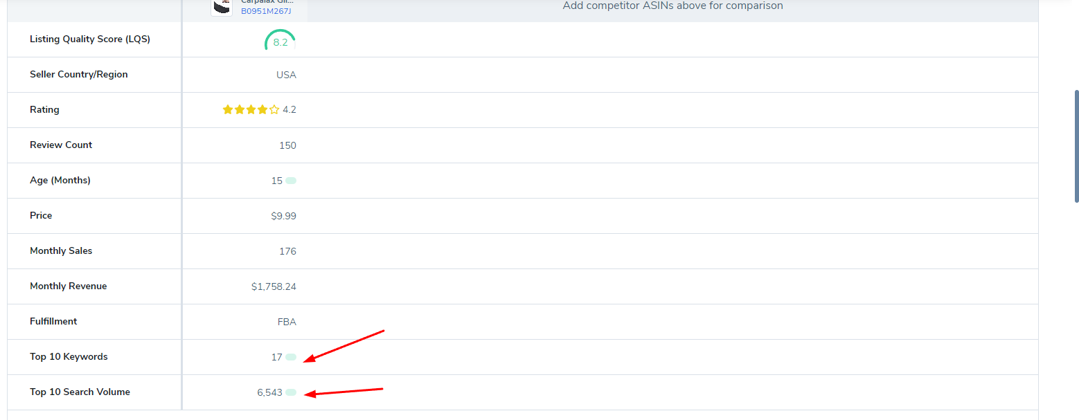
Our top keywords and search volume

Slide 15
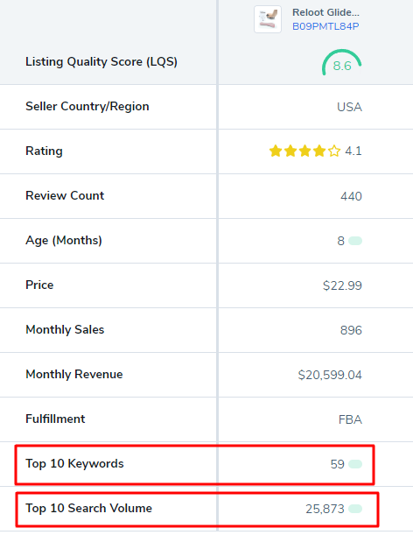
Competitors top 10 key words and there search volume

Slide 16
Solution
We need to revamp our listing with high search volume keywords and do proper keyword indexing for top ranking
Images quality is poor and also not filling the amazon requirements ( https://sellercentral.amazon.com/help/hub/reference/external/1881?ref=efph_1881_cont_43381&locale=en-US ) check this link to see guidelines
We have to remove negative reviews in start of our listing for better conversion
Need to add a professional video to your product listing for better conversion

Slide 17
.
We need to check your amazon ppc keywords report for better understanding to improve conversion .
Thanku

